Slide 1
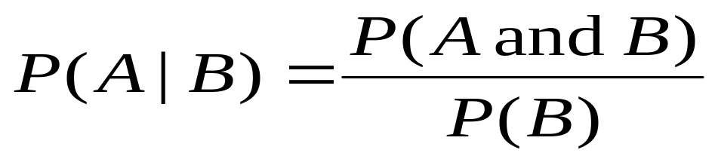
Review
Conditional Probability
  Denoted P(A|B), it represents the probability that A will occur given that B occurred.
Independent events
  Two events A and B are independent if:
    the occurrence of one does not affect the probability of the other.
    P(A|B)=P(A)
    P(B|A)=P(B)
    P(A and B) = P(A) * P(B)

Slide 2
You are given the following information about 25 members of a sports club. Choose a person at random.
a) What is the probability the chosen person is a man and a moderate drinker?
b) If the chosen person is a man, what is the probability he is a heavy drinker?
c) Are the events women and heavy drinker, mutually exclusive?
d) Find two independent events.
 | Heavy Drinker | Moderate Drinker | Non-Drinker
Women | 1 | 7 | 2 | 10
Men | 4 | 8 | 3 | 15
Total | 5 | 15 | 5 | 25

Slide 3
You are given the following information about 25 members of a sports club. Choose a person at random.
a) What is the probability the chosen person is a man and a moderate drinker? 8/25=.32
b) If the chosen person is a man, what is the probability he is a heavy drinker? 4/15=.267
 | Heavy Drinker | Moderate Drinker | Non-Drinker
Women | 1 | 7 | 2 | 10
Men | 4 | 8 | 3 | 15
Total | 5 | 15 | 5 | 25

Slide 4
You are given the following information about 25 members of a sports club. Choose a person at random.
d) Are the events women and heavy drinker, mutually exclusive?
NO
e) Find two independent events.
Non-drinker and Women
Non-drinker and Man
 | Heavy Drinker | Moderate Drinker | Non-Drinker
Women | 1 | 7 | 2 | 10
Men | 4 | 8 | 3 | 15
Total | 5 | 15 | 5 | 25

Slide 5
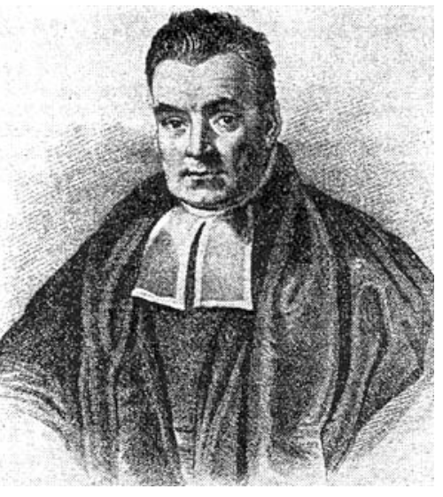
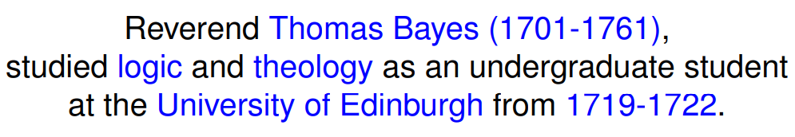

Slide 6

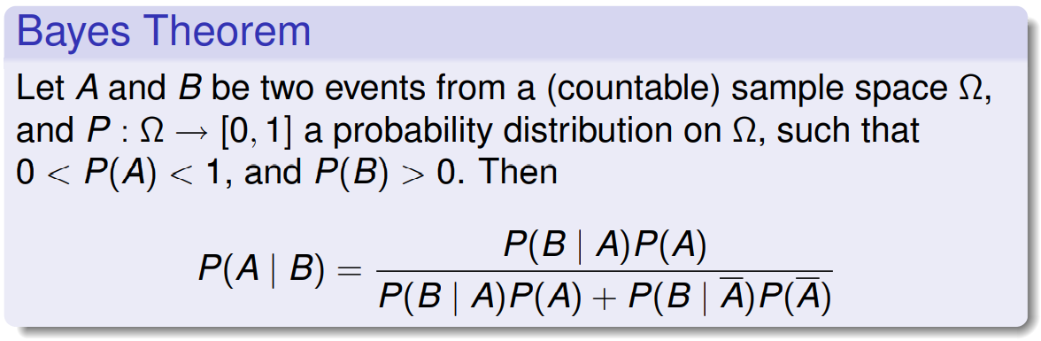

Slide 7
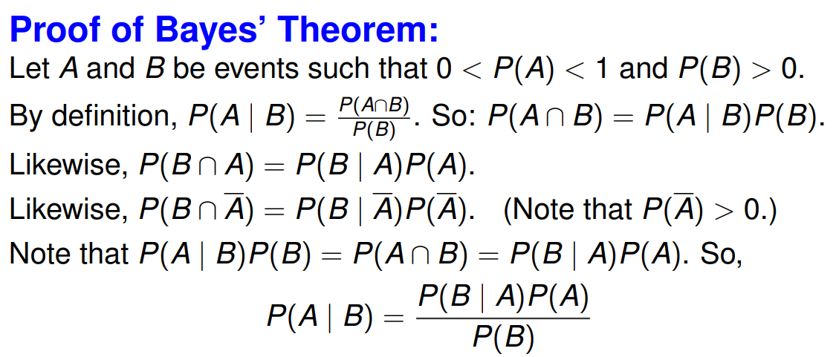

Slide 8
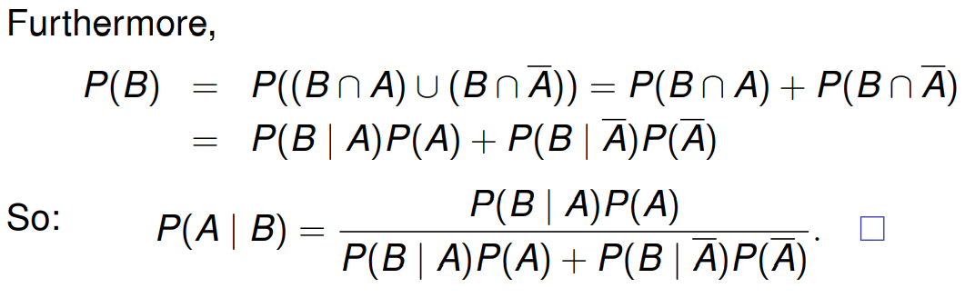

Slide 9
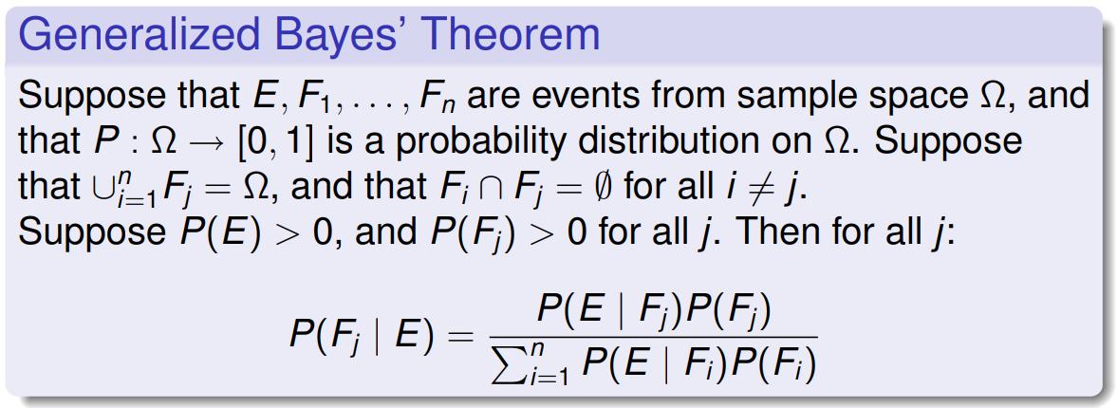

Slide 10
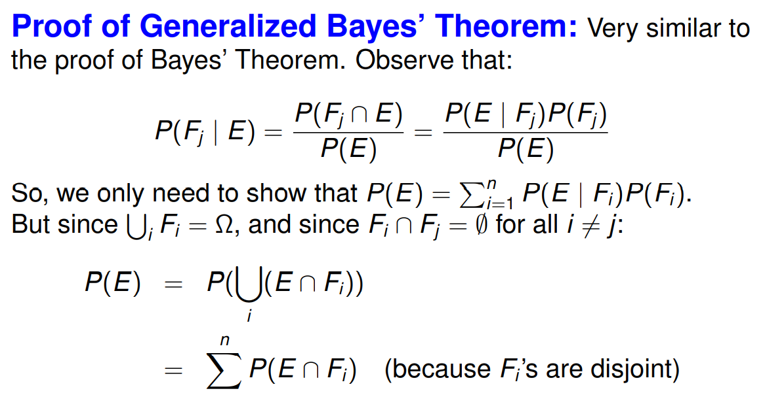

Slide 11
